Slide 1



Scheduling Algorithm Research:
Fleet maintenance optimisation
Data7902 Capstone Project
Presenter: David Long
Notes:
Today I will present the complete journey through both iterations of the scheduling algorithm research. The goal was to improve daily aircraft availability by changing maintenance timing while preserving the maintenance rules. Iteration 1 established the objective and made the search practical. Iteration 2 tested whether a more exploratory method could improve it, investigated starting schedules, and finished a wider hyperparameter study. I will focus on the measured findings and the final recommendation. The supporting diagrams and earlier plots are available after the references for questions.

Slide 2

The scheduling problem
Concurrent maintenance creates dips in fleet availability.
Retiming checks must preserve start windows and maintenance rules.
First: maximise worst-day availability.
Then: reduce standard deviation.
Finally: improve mean availability.
Notes:
The scheduling problem starts when several aircraft enter maintenance at similar times. Availability then falls even if the average across the year looks acceptable. The decision variable is the start of a check inside its legal start window. Checks must not overlap on one aircraft, and changing one check must preserve the sequence and the reset rules for later checks. The score ranks worst-day availability first, lower population standard deviation second, and mean availability last. A smoother schedule cannot compensate for a lower worst day. Random failures and resource shortages motivate the problem, but the reported experiments model scheduled maintenance. Source: CONTEXT.md and the completed technical report dated 12 October 2026.

Slide 3
The project journey
Iteration 1: establish the objective on a simple fleet
Scale to a heavy maintenance forecast
Replace exhaustive and random search with priority selection
Iteration 2: test basin-hopping with tabu polish
Measure the effect of starting schedules
Tune settings across three forecasts
Select the method and settings to take forward
Notes:
The work developed in two iterations. First, a simple ten-aircraft dataset established that local neighbourhood search could reduce maintenance overlap. Scaling to the heavy forecast made candidate evaluation expensive, so the method progressed through random sampling to deterministic priority selection. The second iteration asked whether basin-hopping with tabu polish could escape local optima, how sensitive the result was to the start schedule, and which neighbourhood settings should be retained. The newest study tests the settings on three matched forecasts. This order shows why each change was needed and how the final recommendation follows from the evidence.

Slide 4


Simple fleet proof of concept
10 aircraft, 80 checks. Keep the best feasible improvement at each iteration.
Notes:
The first proof of concept used ten aircraft with eight checks each. Each check lasted sixty days, and the model constrained maintenance intervals to the supplied window. The flowchart shows the basic search loop: calculate daily availability, score the schedule, generate neighbours by shifting one check, reject infeasible candidates, and keep the best improvement. Larger timing changes came before smaller changes. On the right, the resulting simple-fleet schedule retains at least eight available aircraft, which was the original target. This established the objective and feasibility checks before the heavy maintenance model made the neighbourhood much larger. Source: presentations/Iteration 1.pptx and Iteration 1 Milestones.pptx.

Slide 5


The heavy maintenance forecast
24 aircraft and 278 checks
A, B, C and D maintenance checks
Sequence: A B A C A B A D
12-year forecast
Notes:
The heavy forecast contains twenty-four aircraft and two hundred and seventy-eight supplied checks over roughly twelve years. It adds A, B, C, and D check types, with different durations and maintenance reset rules. The repeating sequence is shown on the slide. The availability plot makes the central difficulty visible: long checks can overlap and create a sustained dip. In this model, shifting one check can change the due clocks for later checks on the same aircraft. The optimiser therefore needs to rebuild the later schedule rather than treating every start as an independent variable. The displayed table and plot come from the original iteration presentation.

Slide 6
Scaling the search
The heavy fleet creates over 1,000 neighbours per iteration.
Full evaluation becomes too slow.
Sampling 200 neighbours reduces work.
Random selection can miss a useful move.
Priority selection targets checks that cause the worst days.
Notes:
When the same neighbourhood search scaled to the heavy forecast, an iteration could produce over a thousand candidate schedules. Fully copying, checking, and scoring each one was expensive. Sampling two hundred neighbours reduced the work but introduced uncertainty, because the sample could omit a useful improving move. The next change used the structure of the problem: checks covering the worst availability days are the most relevant place to search first. Priority selection therefore concentrates the work deterministically, while widening the search when a worse priority group cannot improve. Source: Iteration 1 milestone slides 5 to 7.

Slide 7
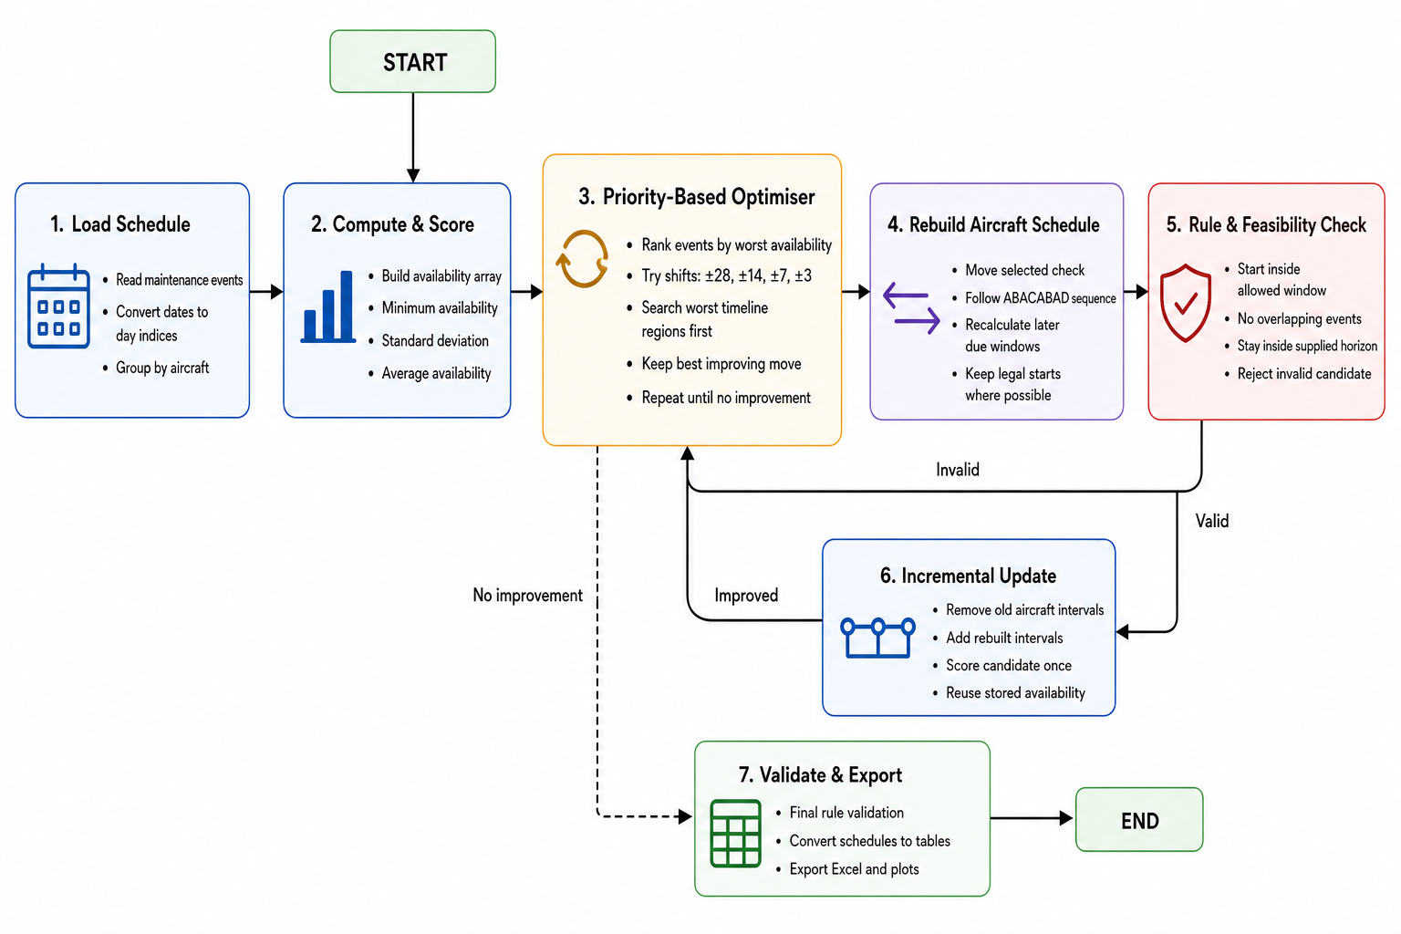
MILESTONE 4 · PRIORITY-BASED SELECTION
Priority selection searches the worst availability regions first
Rank events by the worst availability during their interval.
Search the worst priority level first, expand only if needed.
Move one check, then rebuild later events using A/B/C/D rules.
Update incrementally by removing old intervals and add the rebuilt intervals and score once.
Deterministic, rule-compliant, and substantially faster.
Measured result: min 15→18, std 1.96→1.44.
Notes:
This is the method I want to spend the most time on, because it is the main technical result of iteration 1.
Priority-based selection changes the question we ask. Instead of asking “what happens if we try random moves to find the best one?”, we ask “which maintenance events are actually hurting and causing the minimum availability to be the lowest?”
How this algorithm works is for every event, it gets a priority score equal to the lowest fleet availability of the event for every day it is active. So if an event overlaps a day when only fifteen aircraft are available on that day, then the event priority score is fifteen. Then the events with the lowest priority score will be the ones to be shifted first.
Another thing I changed is that when we move one check, we do not leave the rest of that aircraft’s plan sitting in a potentially broken state. Before, when we move one maintenance check, only that selected event is shifted. Now when an event is shifted, the schedule is rebuilt, everything earlier on the same aircraft stays exactly as it was. Everything later is recalculated from the new shift date using the A/B/C/D rules, so the due dates will remain legal even after getting shifted.
I also changed how scoring works. The entire fleet is not deep copied for every trial. We rebuild one aircraft, then update availability incrementally. That aircraft’s old intervals are removed from the stored availability array, and the new rebuilt intervals are added, and scored once. That is much cheaper than recomputing availability from scratch for every neighbour.
---

Slide 8
PRIORITY-BASED SELECTION
Priority selection targets the worst availability days
Illustration from the original heavy forecast: 24 aircraft and 278 checks
1. Score each check
2. Group by priority
3. Search worst first
Priority equals the lowest fleet availability during that check.
Example: [18, 18, 16, 15] gives priority 15.
Priority 15: 20 checks
Priority 16: 10 checks
Priority 17: 9 checks
Each check belongs to one group.
Try the worst group first.
20 checks × 2 shifts = 40 proposals.
Take the best improvement in that group.
Expand only if it finds none.
Notes:
Each check receives a priority equal to the lowest fleet availability during its maintenance interval. A check covering a day with fifteen available aircraft has priority fifteen. Checks then belong to exclusive priority groups. In this illustration, twenty checks touch the worst days, so a pair of timing shifts produces around forty proposals at that first group. The baseline chooses the best improving move within the first group that can improve the score. If none improves, it expands to the next group. After a move, the later checks on that aircraft are rebuilt and availability is updated incrementally. This combines targeted selection with lower evaluation cost. Source: Iteration 1 Milestones.pptx slides 7 and 8.

Slide 9
ITERATION 1 RESULTS
Priority selection made the heavy search practical
WORST-DAY AVAILABILITY
SEARCH STRATEGY
VALIDITY
15 to 18
Worst days first
Rebuild and verify
Historical runtime comparison from the Iteration 1 milestone
Full neighbourhood
920 s
200 random samples
451 s
Priority selection
15.4 s
Notes:
The historical milestone comparison reported about nine hundred and twenty seconds for full neighbourhood search, four hundred and fifty-one seconds for two hundred random samples, and fifteen point four seconds for priority selection. That is approximately sixty times faster than full search and thirty times faster than the sampled method in that benchmark. The primary result was an improvement from fifteen to eighteen available aircraft on the worst day. These are the historical Iteration 1 measurements. They are not directly comparable with the timings in the new hyperparameter study, which uses a matched scoring window and a verified study driver. Source: Iteration 1 Milestones.pptx slide 9.

Slide 10
ITERATION 2
Three questions guided the second iteration
METHOD
SETTINGS
Escape local optima
Tune the search
Scope of the completed work
Can basin-hopping improve the tuned baseline?
How much does the starting schedule affect the result?
Which neighbourhoods work across three forecasts?
Study scope: scheduled maintenance without operational constraints.
Notes:
The second iteration focused on three questions. Could a method that temporarily accepts a worse schedule improve the tuned hill-climb? How much did the starting schedule affect the result? And which settings worked consistently across the tested forecasts? Operational constraints were part of the earlier plan, but they are outside the scope requested for this final presentation. Maintenance legality remains necessary throughout. I will separate the earlier controlled start-schedule experiment from the new moderate and wide stagger datasets, because those newer datasets change maintenance opening states and are different problem instances. Sources: Iteration 2 execution plan, completed study records, and the final-presentation scope.

Slide 11
CANDIDATE METHOD
Basin-hopping with tabu polish
Baseline search
Candidate search
Prioritise checks on the worst days
Rebuild later checks after a move
Update availability incrementally
Keep only improving schedules
Start from a polished hill-climb schedule
Perturb the schedule to leave a local optimum
Use tabu polish to refine the new schedule
Accept worse basins by temperature
Return the best-so-far schedule
Classic single-chain simulated annealing remains an earlier ablation
Notes:
The baseline is an improving priority hill-climb. The candidate is basin-hopping with tabu polish, built on the same maintenance neighbourhoods. It first obtains a polished schedule, perturbs it to leave the current local optimum, and uses tabu search to polish the new schedule. Temperature then determines whether to continue from a worse basin. The best-so-far schedule is tracked separately and is the result we return. This is more structured than simply accepting every generated neighbour along one annealing chain. Classic simulated annealing remains an earlier ablation and is not the candidate in the comparison that follows. Source: .scratch/iteration-2/spec.md and the 12 October 2026 completed technical report.

Slide 12
ACCEPTANCE AND TESTING
Temporary setbacks with best-so-far reporting
Candidate acceptance
Tightened fallback
Reported result
Temperature can accept a worse schedule, including a lower worst day. These moves become rarer as the search cools.
Reject every move that lowers worst-day availability. Anneal only when the worst day is unchanged.
Always return the best-so-far schedule. Temporary deterioration never replaces the best result.
Matched comparison and keep rule
Same input and half-step neighbourhoods. Report the median of seeds 1–3. Keep only if all seeds retain 18 aircraft, smoothness improves by at least 0.005, and median runtime stays within 300 seconds.
Notes:
The implemented candidate can temporarily accept a lower worst-day availability at high temperature. That differs from the original execution-plan slide, which always rejected a lower worst day. The tightened fallback keeps that stricter rule and anneals only when worst-day availability is unchanged. Both versions return the best-so-far schedule. The decision comparison holds the input and half-step neighbourhoods fixed. The random candidate runs use seeds one, two, and three, and we report their median with their spread. Adoption requires all seeds to retain eighteen aircraft, at least zero point zero zero five improvement in standard deviation, and median runtime within five minutes. Sources: docs/adr/0001-temperature-may-lower-worst-day.md and .scratch/iteration-2/study-results.json.

Slide 13
METHOD COMPARISON
Basin-hopping did not meet the keep rule
Method | Worst day | Std deviation | Runtime
Tuned hill-climb | 18 | 1.391860 | 115.6 s
Basin-hopping median | 18 | 1.390417 | 306.3 s
Tightened median | 18 | 1.391860 | 63.5 s
Smoothness gain: 0.00144 against a 0.005 threshold. Median runtime exceeded 300 s.
Earlier decision benchmark. Candidate seeds 1–3. Two candidate runs reached the time budget.
Notes:
On the original decision benchmark, all reported methods retained eighteen aircraft on the worst day. The tuned hill-climb achieved standard deviation about one point three nine two in one hundred and fifteen point six seconds. Basin-hopping improved the median standard deviation by only zero point zero zero one four four, below the required zero point zero zero five. Its median runtime was three hundred and six point three seconds, just over the five-minute limit. Two runs reached the time budget. Tightened acceptance matched the hill-climb quality. The candidate therefore failed both the smoothness threshold and the runtime criterion. These values use the earlier decision-study horizon and must not be compared numerically with the later matched hyperparameter scores. Source: .scratch/iteration-2/study-results.json, decision section.

Slide 14
CONTROLLED START SCHEDULES
The as-loaded start finished smoothest
Start schedule | Initial worst day | Final worst day | Final std deviation
As-loaded | 15 | 18 | 1.391860
Bunched | 15 | 18 | 1.404629
Spread | 15 | 18 | 1.417282
Same original checks and due dates. Tuned hill-climb endpoints shown.
The later moderate and wide stagger datasets change maintenance ages and check mix. They are different problem instances.
Notes:
This earlier experiment changes the opening start schedule for the same original checks and due dates. The three starts are as-loaded, bunched, and spread. All begin at a worst-day availability of fifteen and finish at eighteen with the tuned hill-climb. The as-loaded start finishes smoothest. Basin-hopping adds a small smoothness improvement on each start but takes longer. This supports retaining the as-loaded start for that original instance. It does not show that a more widely staggered fleet is always worse. The new moderate and wide datasets have different maintenance ages and check mixes, so their results answer a different question. Source: .scratch/iteration-2/study-results.json, stagger section.

Slide 15
HYPERPARAMETER STUDY
58 settings across three matched forecasts
174 matched sweep cases, 203 completed run records
Settings: shift magnitudes, ladder order, priority selection and iteration budget
Inputs: original, moderate stagger and wide stagger forecasts
Matched window: 21 January 2026 to 18 January 2038
Checks: preserve opening due clocks, freeze commenced checks, replay rules and independently recompute availability
Each input is a distinct maintenance instance. Compare tuned and default settings within the same dataset.
Notes:
The completed hyperparameter study crosses fifty-eight neighbourhood and selection settings with three actual input workbooks, giving one hundred and seventy-four matched sweep cases and two hundred and three total run records. All use the same forecast dates, from twenty-first January 2026 to eighteenth January 2038. The aged fleets retain their saved sequence positions and due clocks, and checks already commenced before the benchmark are frozen. Endpoints receive full rule replay and independent daily availability checks. Serial finalist timing repeats follow the parallel sweeps. The original, moderate, and wide inputs are distinct maintenance problem instances. We compare tuning against the default within each one, rather than calling their differing inputs an algorithm gain. Source: docs/reports/2026-10-14-priority-hyperparameter-analysis-three-datasets.docx.

Slide 16
HYPERPARAMETER RESULTS
Tuning improved smoothness on every forecast
Dataset | Initial worst day | Tuned worst day | Default std | Tuned std | Best setting
Original | 15 | 18 | 1.4221 | 1.4019 | C57
Moderate | 16 | 19 | 0.9117 | 0.8834 | C30
Wide | 17 | 20 | 0.6167 | 0.5868 | C30
Smoothness improvement at the same worst day: 1.42%, 3.10% and 4.85%
Serial median search time: C57 original 32.16 s. C30 moderate 14.69 s, wide 28.55 s. Three repeats per setting on this machine.
Matched scoring window. All listed winners reached local exhaustion.
Notes:
The best measured setting on the original forecast is C57, half steps plus forty-two days. It retains eighteen aircraft and improves smoothness by one point four two percent against the default. Moderate and wide stagger both favour C30, the wide dense ladder. They retain nineteen and twenty aircraft respectively, with smoothness improvements of three point one and four point eight five percent. All listed winners naturally exhausted their improving neighbourhoods. The previous half-step setting reaches only nineteen aircraft on wide stagger, while the default reaches twenty, so it cannot be adopted universally. Serial timings are local-machine medians, and repeated deterministic endpoints agree. Source: the three-forecast report dated 14 October 2026 and .scratch/priority-hyperparameter-analysis/three-dataset-summary.json.

Slide 17
RECOMMENDED SETTINGS
A wide dense ladder works across these forecasts
Shared setting: C30
Dataset-specific option
Shift levels, in order:
±56, ±42, ±28, ±14, ±7, ±3, ±1 days
Use first-level selection
Set a 400-iteration cap
Original forecast: C57
Half steps plus 42 days
Moderate and wide: C30
C30's original smoothness penalty is 0.56%.
Earlier half steps reach 19 on wide, compared with 20 for C30.
Notes:
C30 is the shared recommendation among naturally converged configurations that retain each dataset's best measured worst day. Its shift levels range from plus or minus fifty-six down to plus or minus one day, and it retains first-level priority selection. A four-hundred-iteration cap covers the observed convergence counts with room to confirm no further improvement. On the original input, C30 has only zero point five six percent worse smoothness than the dataset winner. C57 is appropriate when that final original-input smoothness improvement matters. The frozen default stays the reference baseline, and future comparisons should challenge the tuned baseline on each input with matched dates and opening states. Source: three-forecast report, shared-settings recommendations.

Slide 18
LIMITS AND NEXT STEPS
The original worst-day target is already optimal
Original forecast
Stagger datasets
Six D checks must overlap in a fixed interval.
With 24 aircraft, worst-day availability cannot exceed 18.
The measured result reaches this bound.
The upper bound is 21 on each stagger dataset.
Measured results reach 19 and 20.
Those remaining gaps are unresolved.
Evidence boundary
Smoothness is locally optimal only. These are synthetic, maintenance-only benchmarks. A new fleet, regenerated check list, or changed rules needs a fresh study.
Notes:
The original forecast has a useful bound on the primary objective. A D check lasts one hundred and twenty-six days and has a seventy-day early allowance, so each first D check must cover a fixed fifty-six-day interval beginning at its due date. Six of those mandatory intervals overlap in the original fleet. With twenty-four aircraft, no legal schedule can exceed eighteen available aircraft on every day. Our result reaches that bound. For the two stagger inputs, the corresponding upper bound is twenty-one, while the measured results reach nineteen and twenty. Those gaps remain unresolved. These bounds do not prove globally optimal smoothness. Source: the three-forecast report, limits of the evidence section.

Slide 19
FINAL RECOMMENDATION
Priority selection remains the method to take forward
METHOD
SHARED SETTINGS
Priority hill-climb
C30, cap 400
Project outcome
Iteration 1 raised original worst-day availability from 15 to 18.
Basin-hopping offered too little smoothness gain for its runtime.
Three-dataset tuning supports C30 as the shared setting.
Use C57 when the original forecast needs the best measured smoothness.
Notes:
The final recommendation is to retain the priority hill-climb. Iteration 1 delivered the major practical improvement: raising original worst-day availability from fifteen to eighteen and reducing search cost. Iteration 2 showed that basin-hopping's small smoothness gain did not justify its runtime in the decision benchmark. The completed three-forecast study now supports C30 as the shared tuning choice, with C57 as the original-input option. The method, input opening state, and scoring window need to stay explicit in future comparisons. The remaining work is broader validation on new fleets and investigation of the unresolved stagger-input gaps. That completes the project journey, and I am happy to take questions.

Slide 20
References
Pippin, Bradley W. Allocating Flight Hours to Army Helicopters. PhD thesis, Naval Postgraduate School, 1998.
U.S. Army, Black Hawk helicopter celebrates 40 years of aviation service with the Army, 2018.
Winata, Leonard. Heuristic approaches for flight and maintenance planning of Large Fleets. Doctor of Philosophy Thesis, RMIT University, 2011.
Project evidence: Iteration 1 milestone deck, completed technical report (12 Oct 2026), three-forecast hyperparameter report (14 Oct 2026), and saved study results.
Notes:
References for the historical motivation and method review are retained here. Internal evidence for the completed work is the 12 October 2026 technical report, the 14 October 2026 three-forecast hyperparameter report, .scratch/iteration-2/study-results.json, and the frozen study records. Detailed diagrams and historical plots follow as backup material.

Slide 21

Backup: simple fleet input
10 aircraft with 8 checks each
80 checks, each lasting 60 days
Maintenance intervals of 320–380 days
The random start creates overlapping maintenance
Goal: keep at least 8 aircraft available
Notes:
Backup input description for the ten-aircraft proof of concept. Each aircraft has eight sixty-day checks. The source model constrains intervals to 320–380 days. The starting plan has major overlaps. The optimisation target is at least eight available aircraft, equivalent to no more than two offline. Source: Iteration 1.pptx.

Slide 22

Backup: historical availability result
Original
Min Availability: 15
Availability S.D.: 1.947
Average Availability: 21.694
Optimised
Min Availability: 18
Availability S.D.: 1.433
Average Availability: 21.712
Notes:
Backup historical plot from the Iteration 1 presentation. The displayed original and optimised scores belong to this historical run and its horizon. Do not combine its standard deviation or mean with the newer matched-window hyperparameter scores. The plot illustrates how timing changes remove the deepest maintenance dip. Source: Iteration 1.pptx.

Slide 23
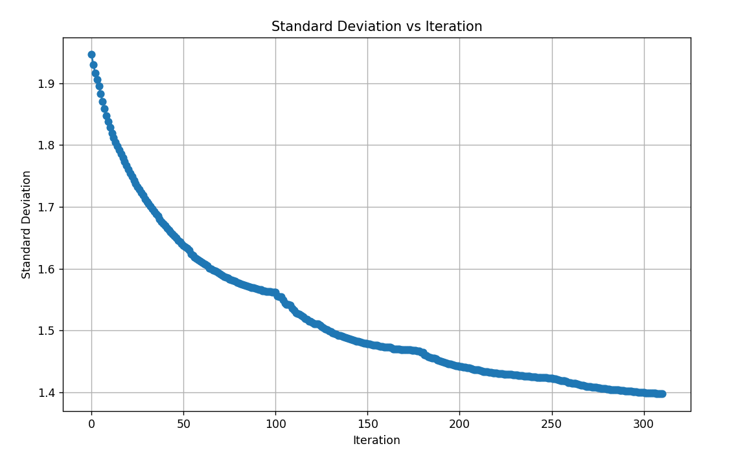
Backup: historical VNS convergence
Standard Deviation of fleet availability decreases over iterations
Final value converges to ~1.40
Around iteration ~100, the algorithm transitions between shift sizes
Earlier iterations relied on large shift sizes (±28)
Later iterations focused on local optimisation (±14, ±7, ±3)
Algorithm terminated at iteration 311 (no improvement found)
Notes:
Backup historical convergence trace. The plot shows standard deviation decreasing as improving moves accumulate, with larger shifts earlier and finer shifts later. It stops after the tested neighbourhoods find no improvement. This is local convergence, not proof of global smoothness optimality. These historical values are separate from the three-forecast study. Source: Iteration 1.pptx.

Slide 24
BACKUP: SIMULATED ANNEALING
Simulated annealing
1. Search
2. Accept
3. Cool down
Same priority-based selection neighbour search algorithm
Better moves are always kept. Worse moves can still be kept early on, by chance.
Over time we accept fewer worse moves, so the search settles on a strong plan.
Why it helps
Think of the search like walking over hills. Today’s method only walks uphill. That is fast and safe, but you can get stuck on a steep part of the hill when a better peak is nearby.
Simulated annealing sometimes takes a downhill step early, so you can leave a trap and reach a better overall schedule. As the search “cools,” those downhill steps become rare, and we settle on the best plan we found.
Notes:
Backup explanation of simulated annealing. Temperature allows temporary worsening to leave a local optimum, with fewer worse moves as the search cools. The returned schedule remains best-so-far. The final comparison uses basin-hopping with tabu polish rather than classic single-chain simulated annealing. Source: Iteration 2 Execution Plan.pptx and the completed technical report.

Slide 25
BACKUP: PRIORITY SEARCH
Priority selection and schedule rebuild
Rank checks by the worst day they cover.
Search the worst priority group first.
Move one check, then rebuild the later checks on that aircraft.
Remove old intervals and add rebuilt intervals to availability.
Verify maintenance rules and non-overlap.
Notes:
Backup detailed priority-search flowchart. Moving one check triggers a rebuild of that aircraft's later checks using the maintenance sequence and due-reset rules. Availability is updated by removing its old intervals and adding its rebuilt intervals. Every retained endpoint must satisfy maintenance rules and non-overlap. The full fleet need not be deep-copied and recomputed for each proposal. Source: Iteration 1 Milestones.pptx slide 7.

